Slide 1

Mohamed Noordeen Alaudeen
Senior Data Scientist
Day 1
28-07-2018
Introduction

Slide 2



ABOUT ME

Slide 3
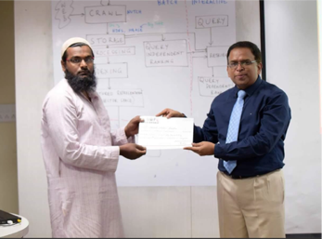
Won Hackathons

Slide 4
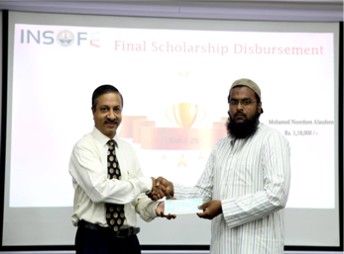
Best project award

Slide 5
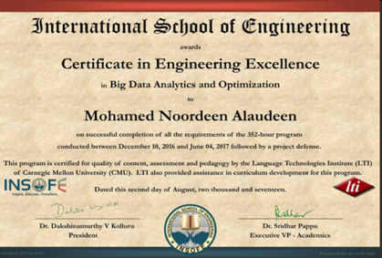
Best Student of the batch

Slide 6
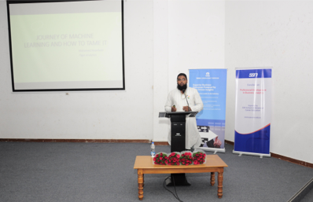
College Connects
Notes:
SSN, Panimalar, Velammal

Slide 7
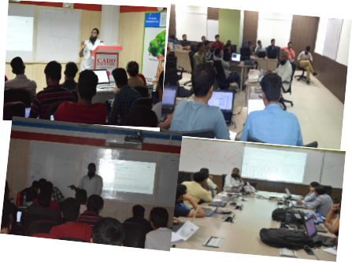
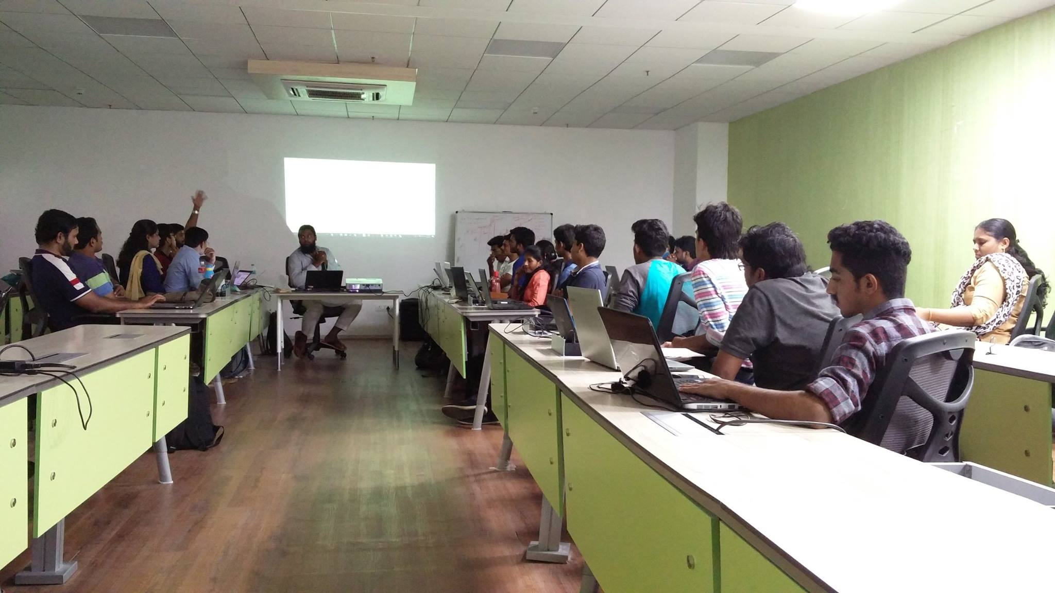
Partnering with colleges and Research Institute
Notes:
I Democratize ML, Evangelist ML
I help people to understand ML

Slide 8



MY WORK OUTSIDE THE WORK
https://github.com/nursnaaz
https://www.linkedin.com/in/nursnaaz/
http://www.technaaz.com/

Slide 9
Learn by doing
and
Teach what you have learnt
-Noordeen

Slide 10
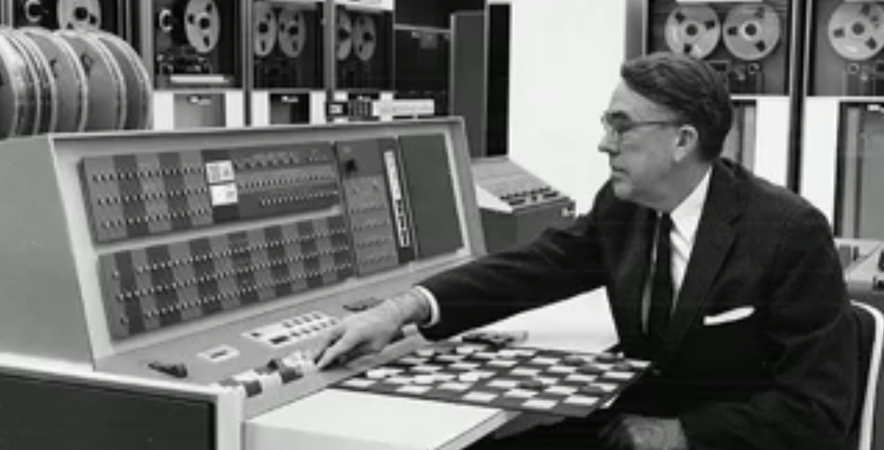

Slide 11
Arthur Samuel

Slide 12
Father of Machine learning 1956 – Trains computer to play checkers 1962 – Computer defeated the state champion

Slide 13
Example isn’t another way to teach, it is the only way to teach
-Albert Einstein

Slide 14
What Machine learning did in past and doing today and in future

Slide 15
PROBLEM SET
A Specific metallic component is wearing out with use in an acidic environment
How do we understand and use this component?

Slide 16
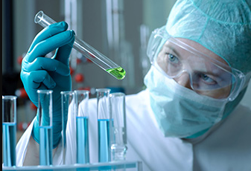
Approach 1: Science
A chemist studies what happens to the material in acid and
understands that the metal is reacting with the hydrogen in the
acid to form a vapor
Comes up with a equation and science behind

Slide 17
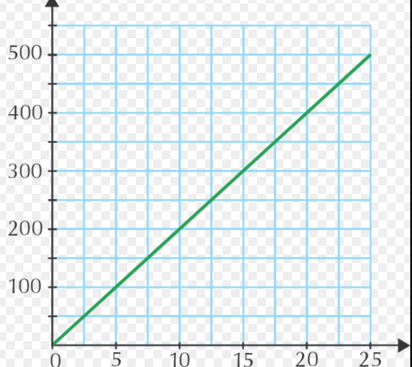
Approach 2: Engineering
An engineer tests the degradation in a few concentrations and
temperature, plots the degradation, validate the theory and
comes up with the thumbs up rule

Slide 18
Deductive learning
A few hypothesis that cannot be proved
Rest of science is developed by extending these using mathematics
and experiments

Slide 19
Inductive Learning
Measure the degradations in hundreds of conditions (temperatures and concentrations for various times)

Slide 20
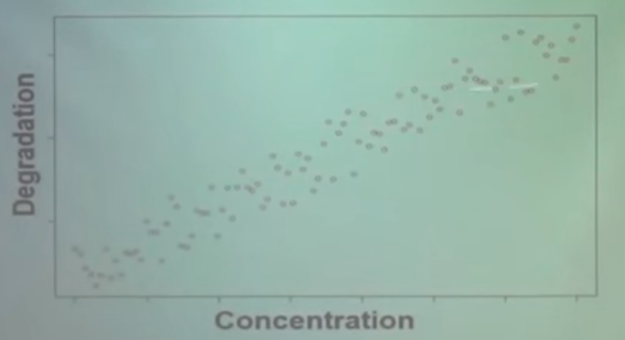

Slide 21
Result is same but
Do not know the reasons(causations are not known and only correlations are identified)
Walmart example(does not tell how to act)
Marketing customer(does not tell the reason)

Slide 22
Where it does not work
Fails when randomness prevails
Need a lot of data to come to the correct conclusions

Slide 23
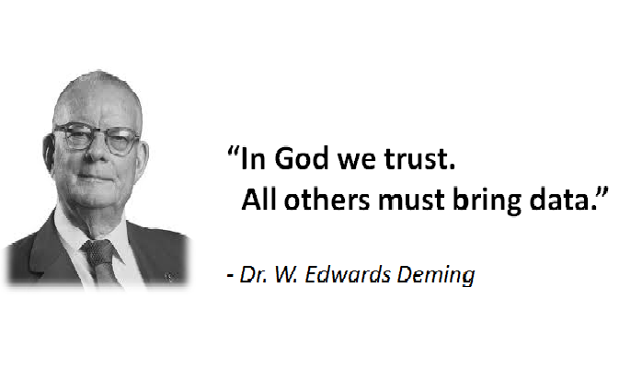

Slide 24
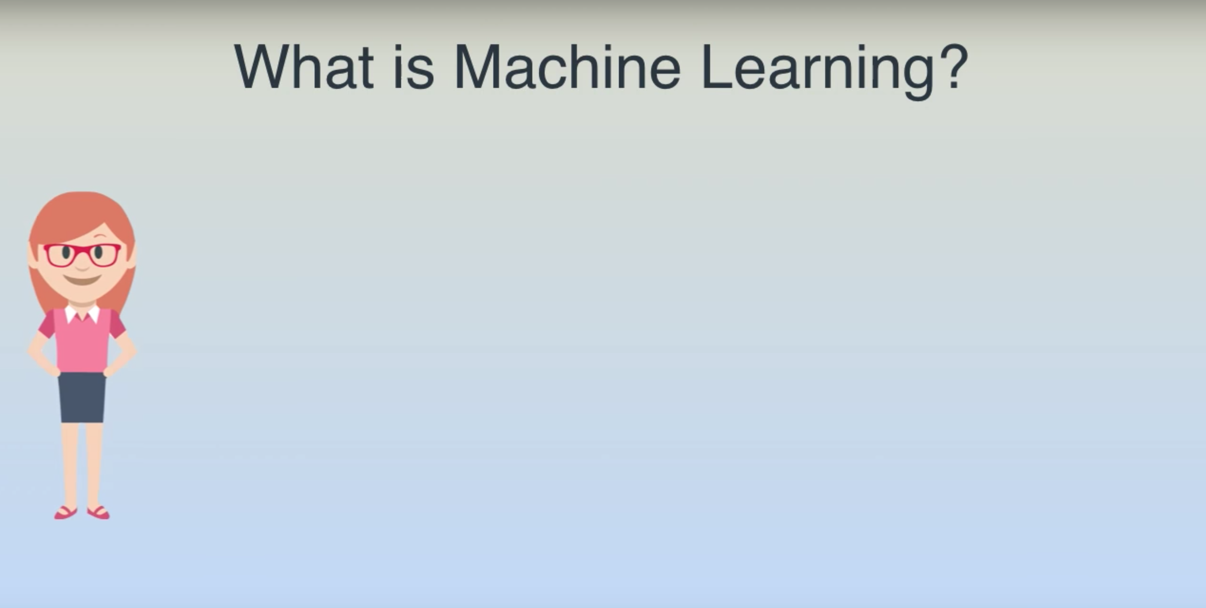

Slide 25
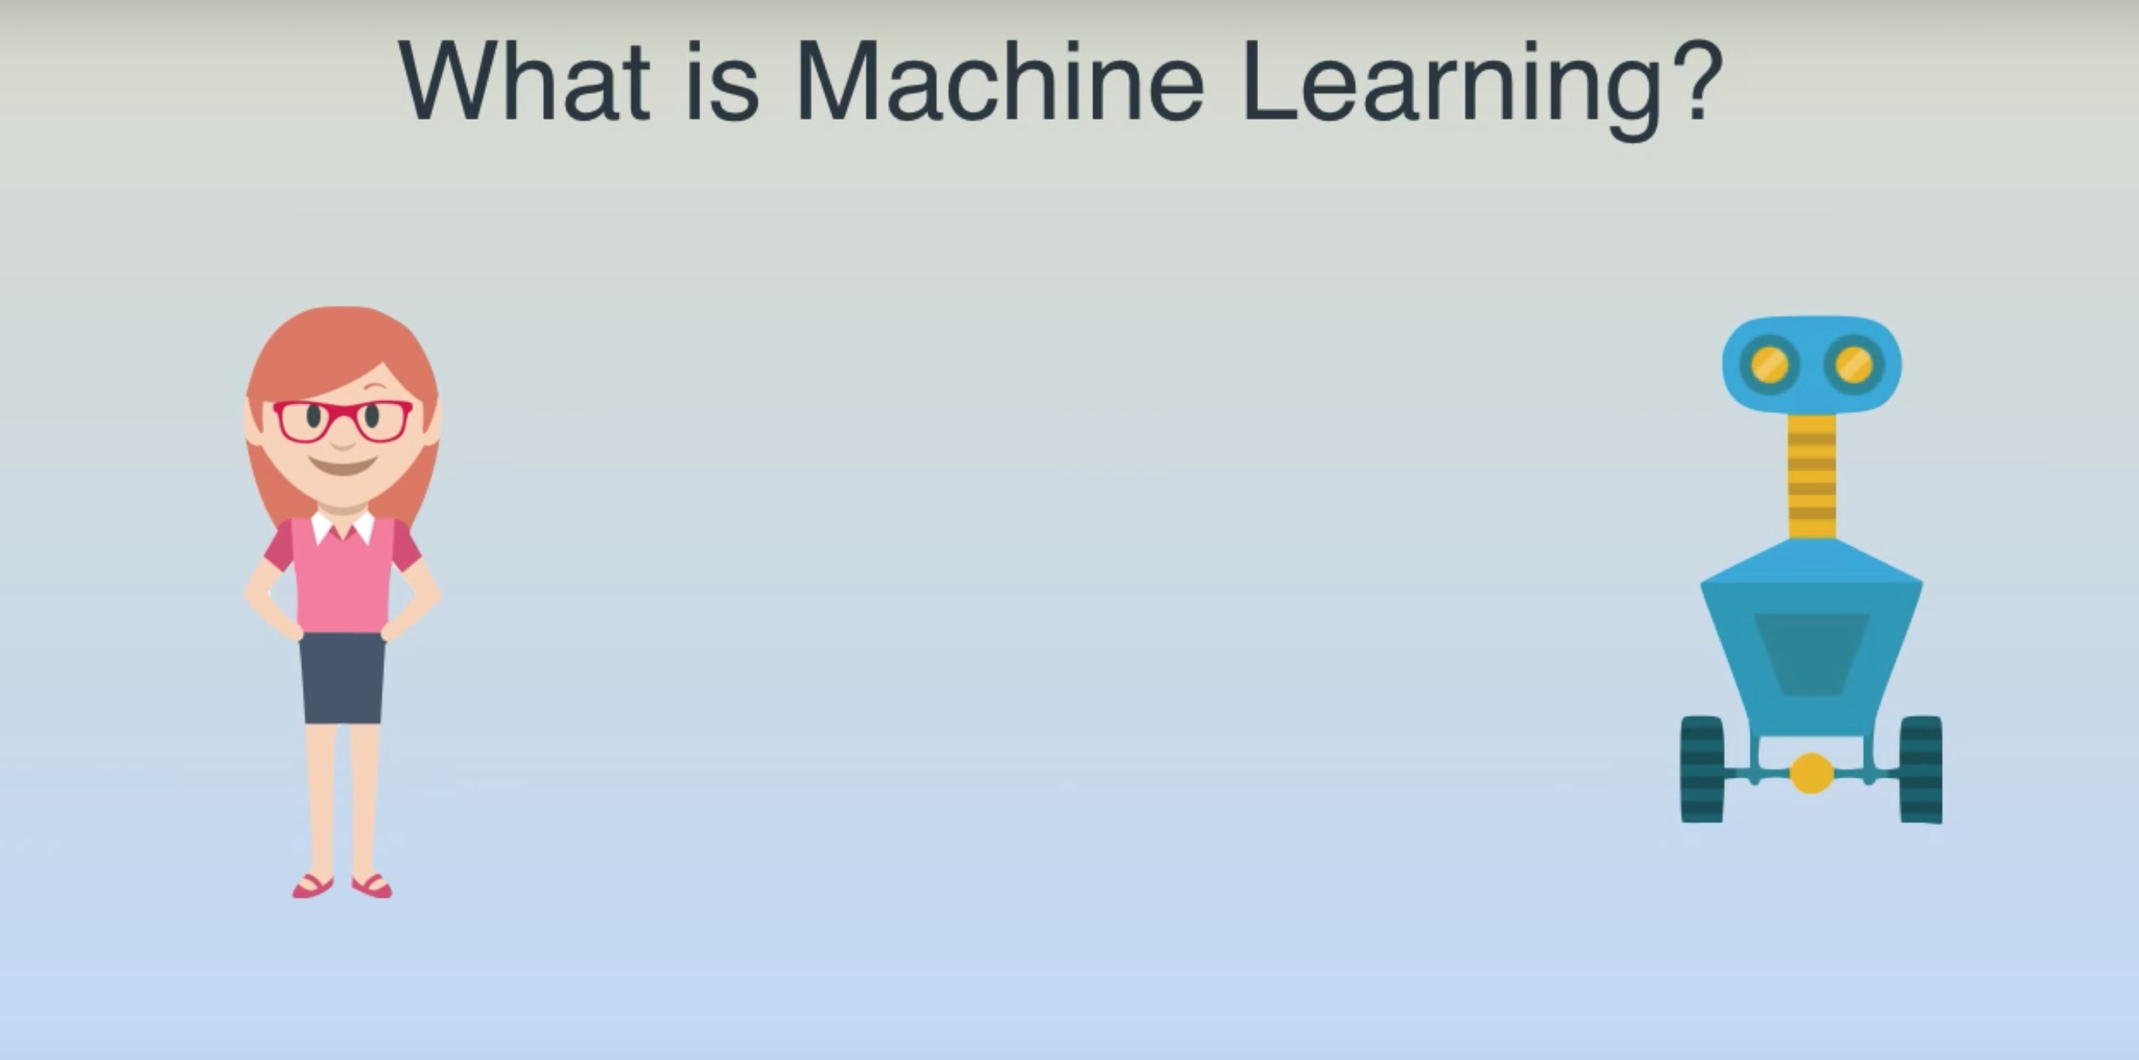

Slide 26
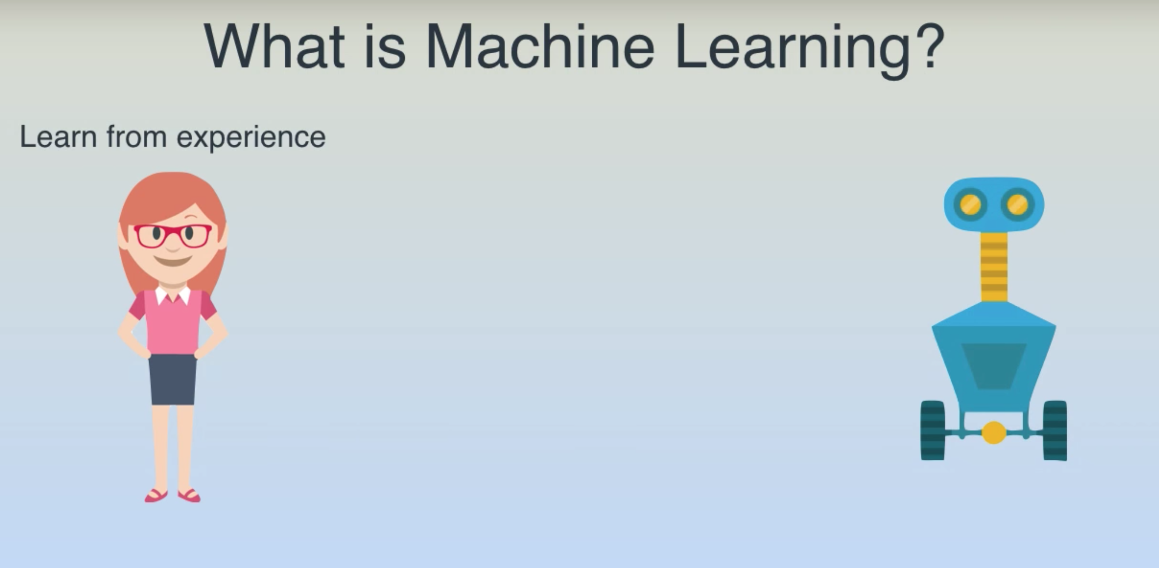

Slide 27
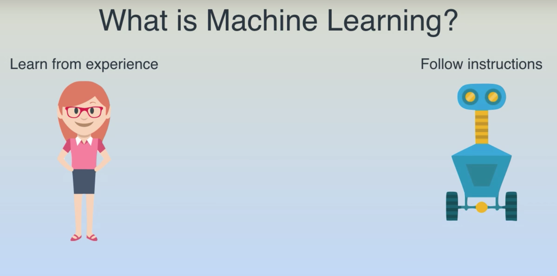

Slide 28
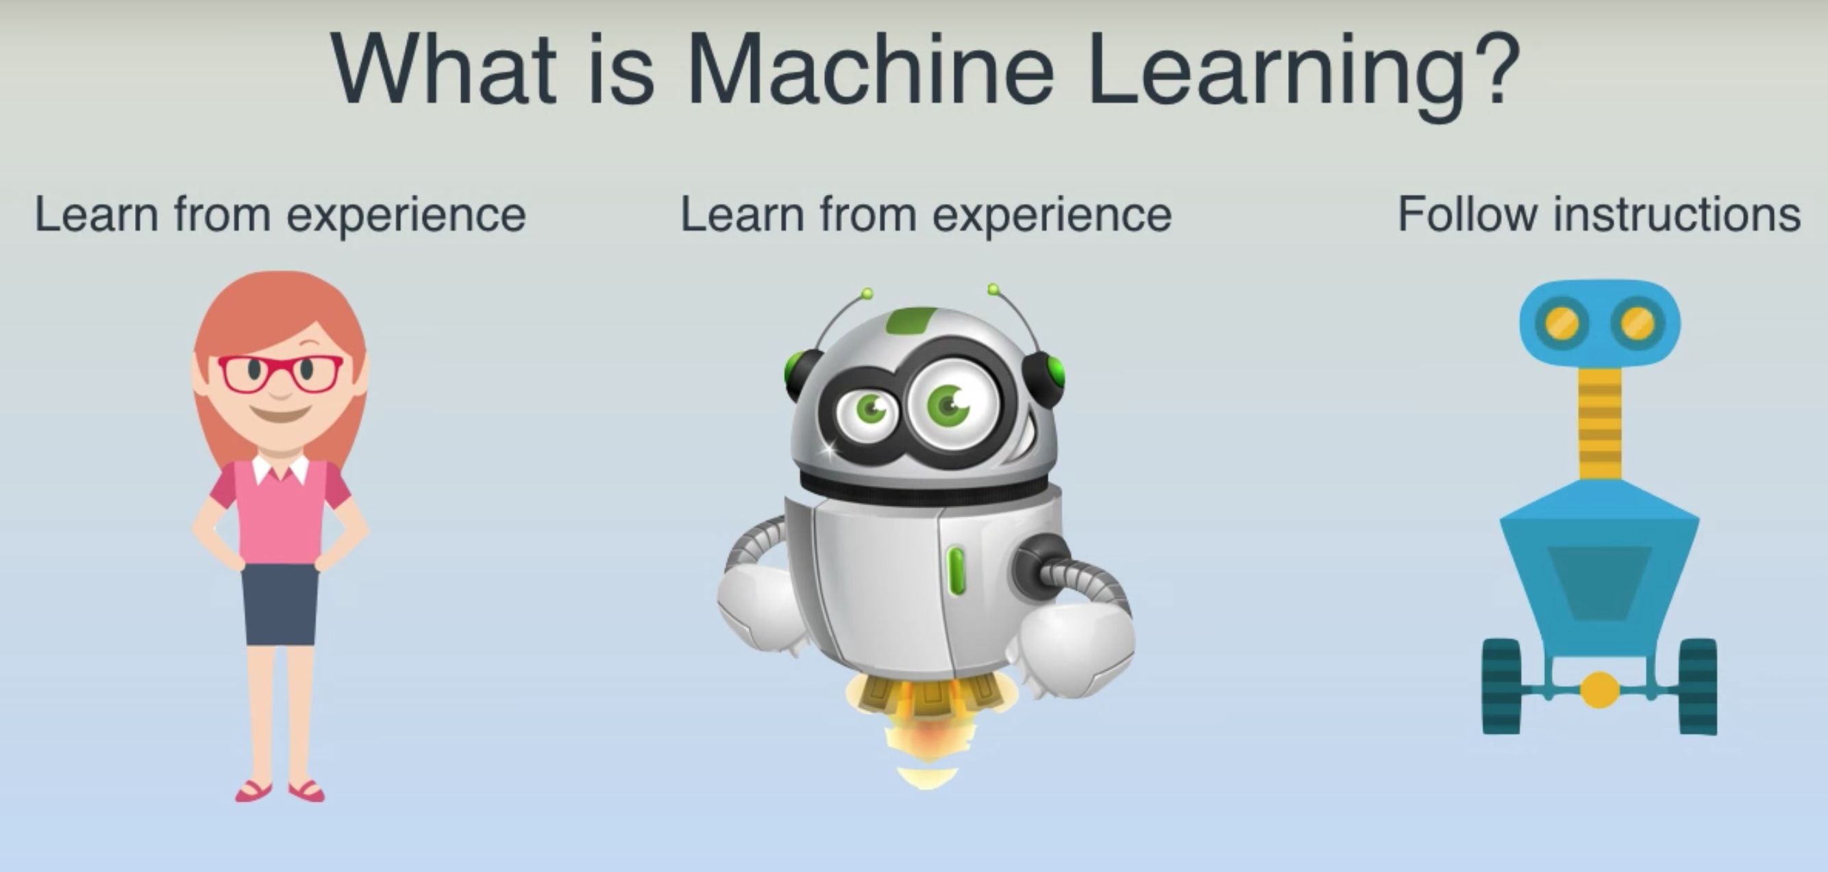

Slide 29
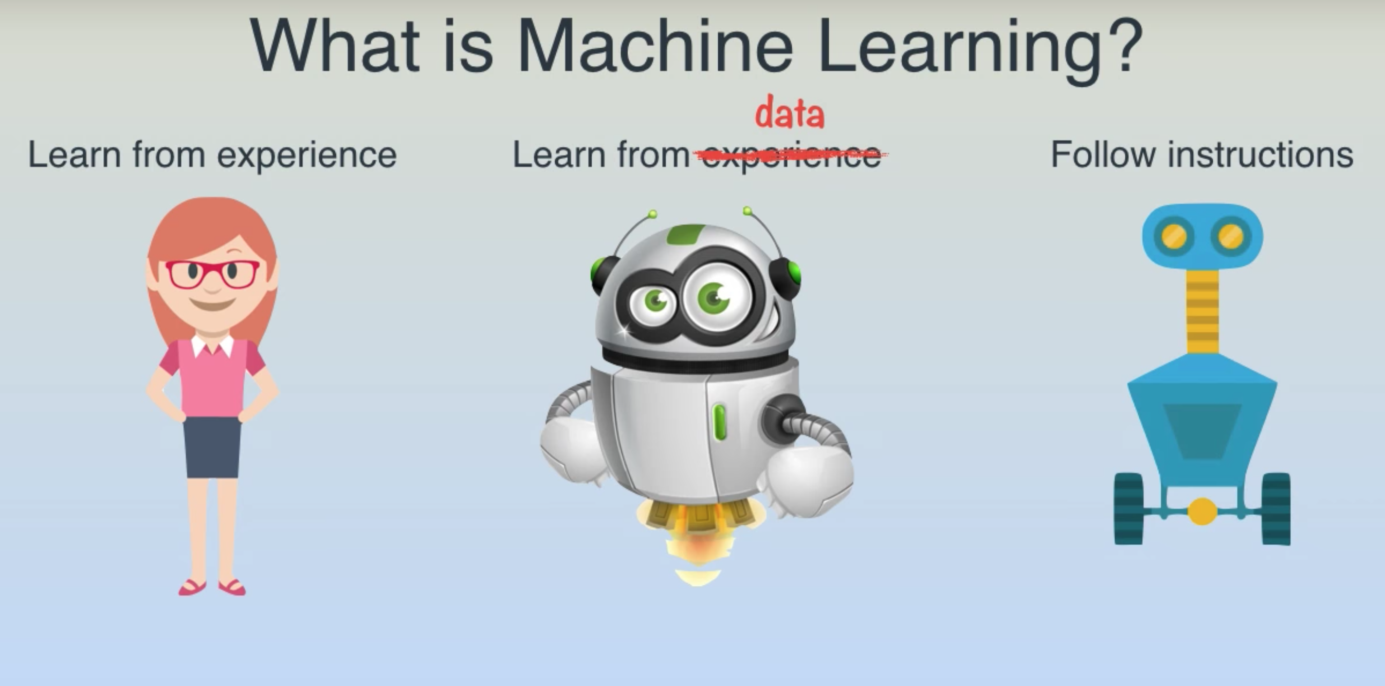

Slide 30
Use case

Slide 31
Find the house price?

Slide 32
Traditional Way
def detect_houseType():
#lots of code
def detect_houseStandard():
#lots of code
def define_standards():
#lots of code
def define_type():
#lots of code
……………….
……………….
……………….
def findPrice(city, yearBuilt, bedrooms, bathrooms , squareFeet, floors):
if(city==“A”):
#lots of code
elif(city == “B”):
#lots of code
elif(city == “C”):
#lots of code
……………………..
……………………..
……………………..
Collecting Data
City
Year Built
Floors
Bedrooms
Bathrooms
Square-foot
Business Logic
Analyze
Brainstorm
Design
Build the application
Notes:
Requirement changes,
Rules,
Government regulation
Another system
Maintenance
Flop

Slide 33
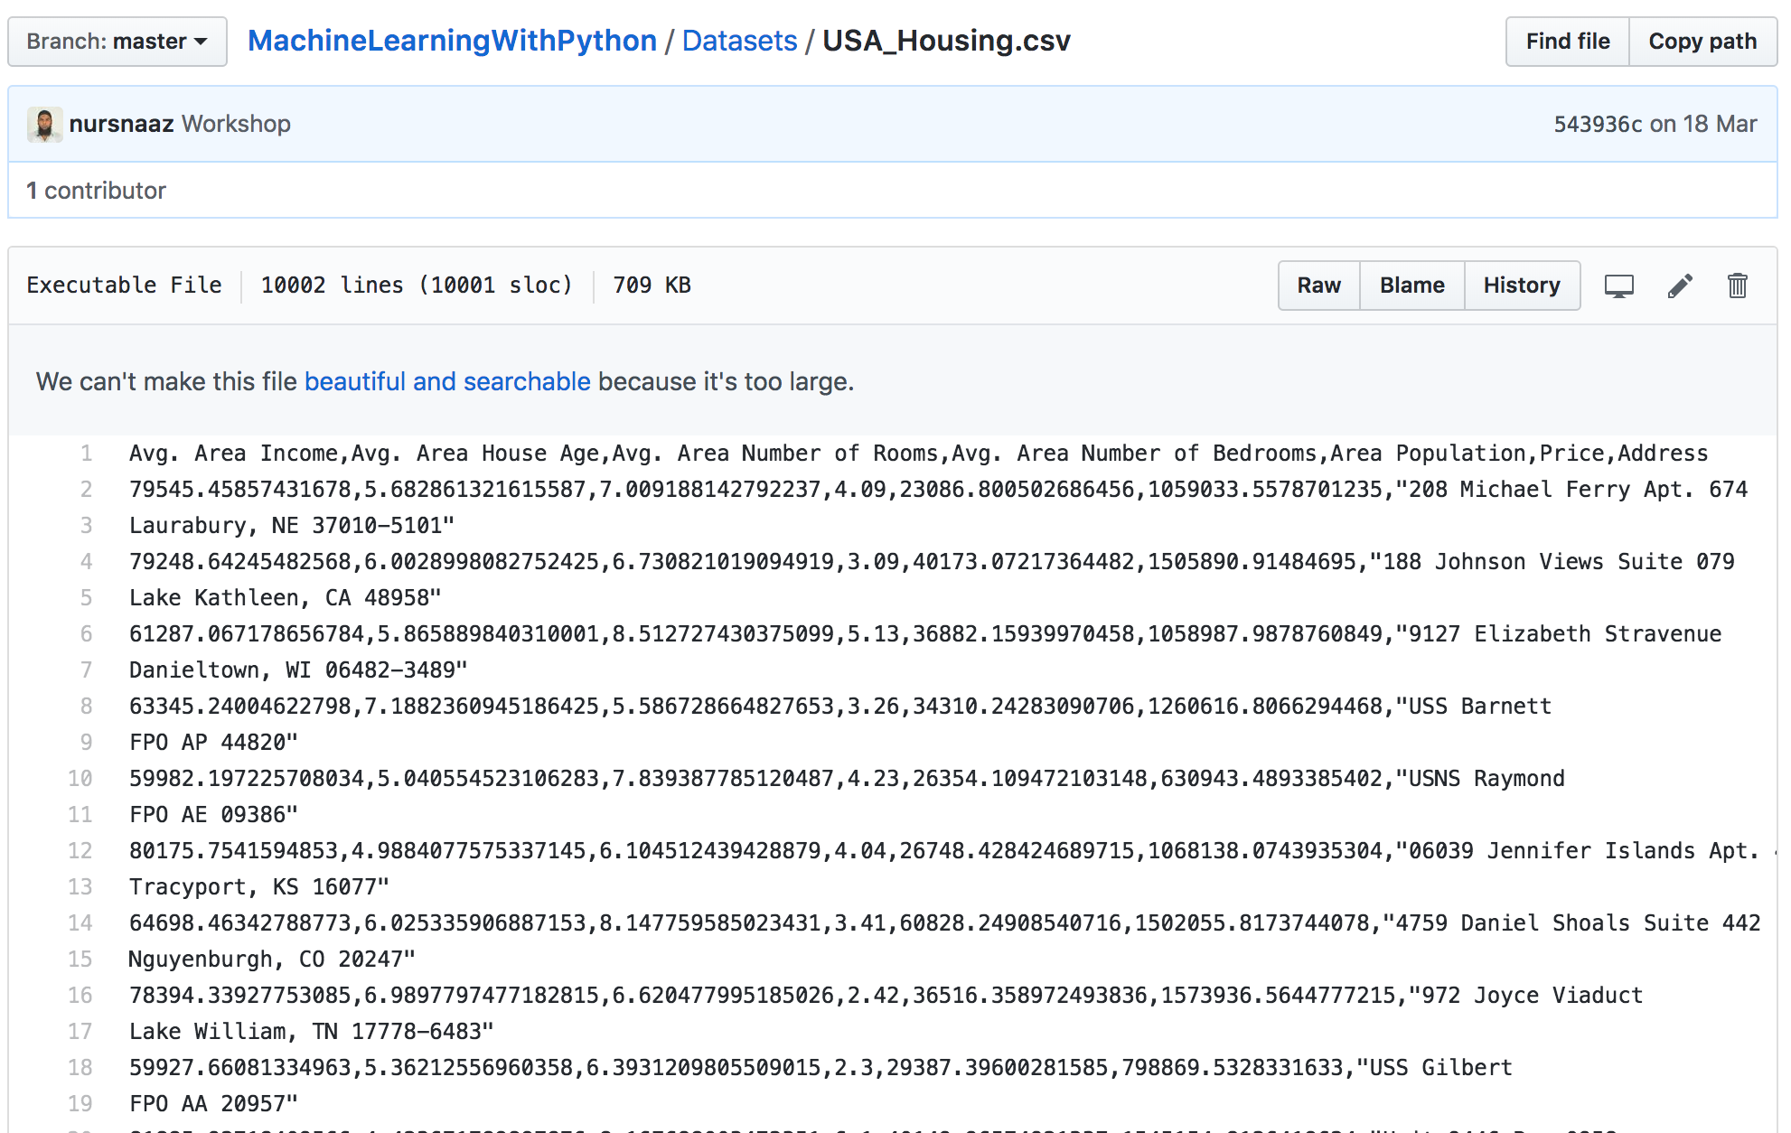
Machine Learning way
Give lots of Example to a function

Slide 34
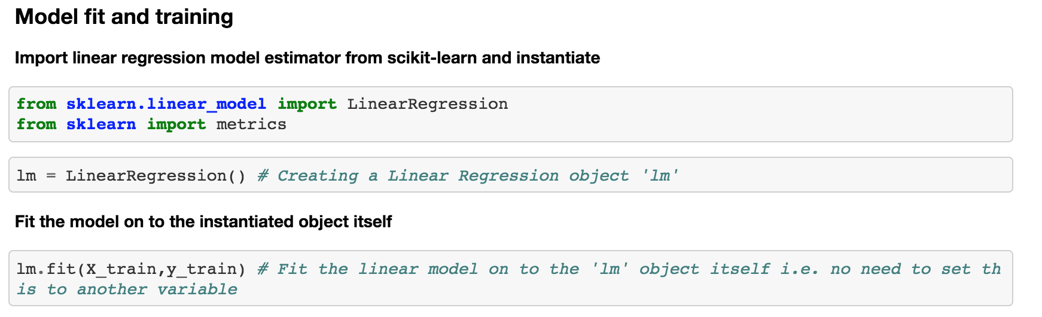
Run Machine Learning Algorithm
Algorithm doesn’t know business
By Sophisticated Mathematic process
Will figure out the logic behind it

Slide 35
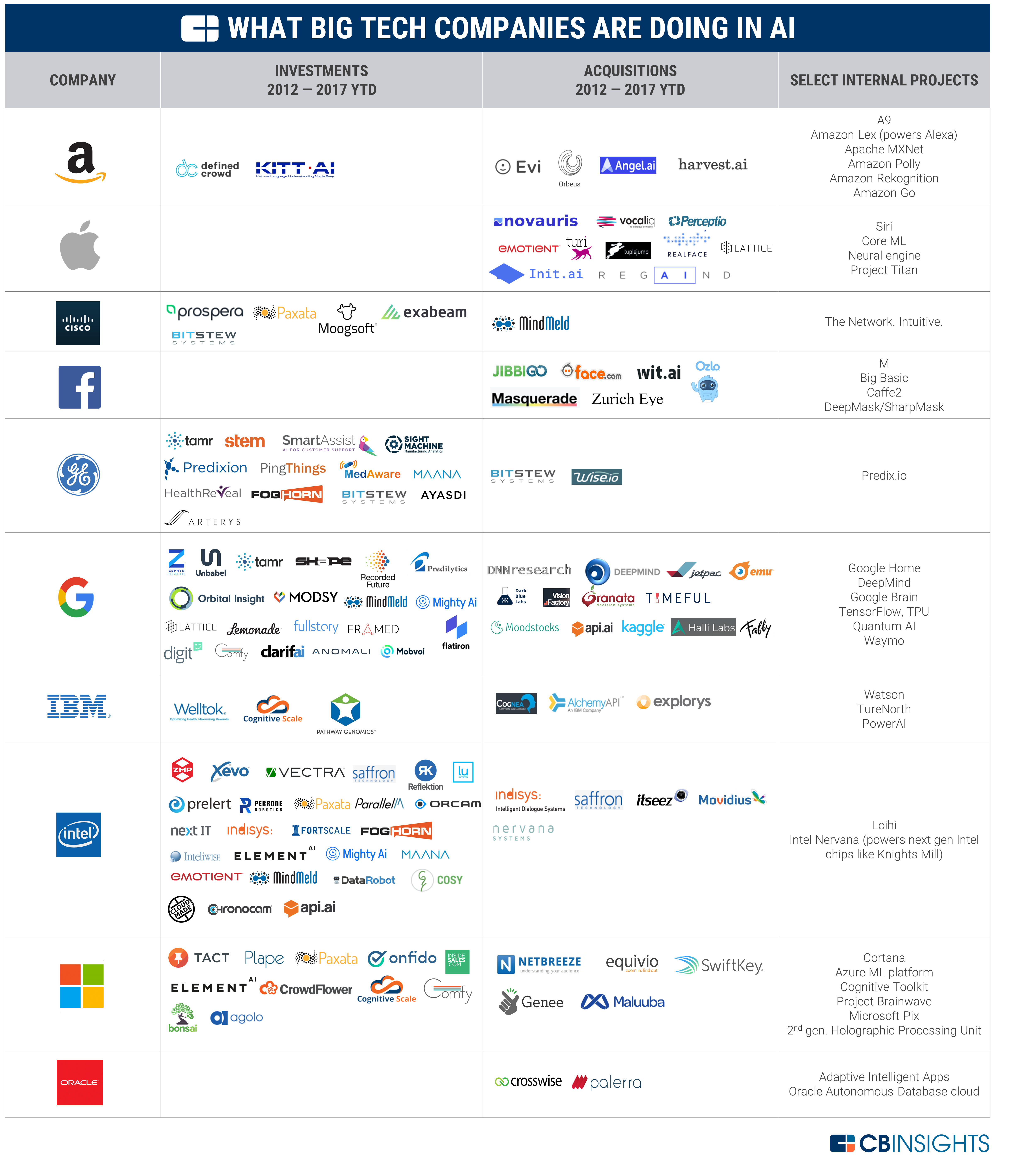
Notes:
Google, Amazon Recommendation, Facebook Recommendation, Linkedin Recomendation, Netflix Recommendation

Slide 36
What Machine Learning can do to Logitech?

Slide 37
Increasing the profit

Slide 38
Operational Efficiency

Slide 39
Increased Customer Service

Slide 40
Decreasing the Unnecessary cost

Slide 41
Why Now?

Slide 42
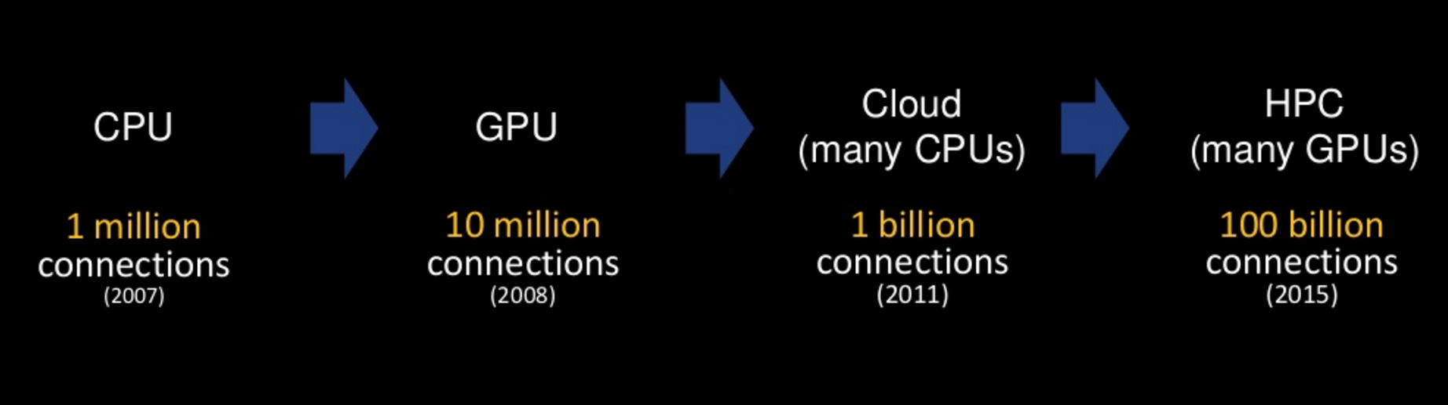
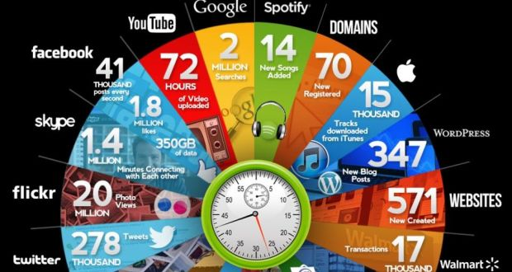
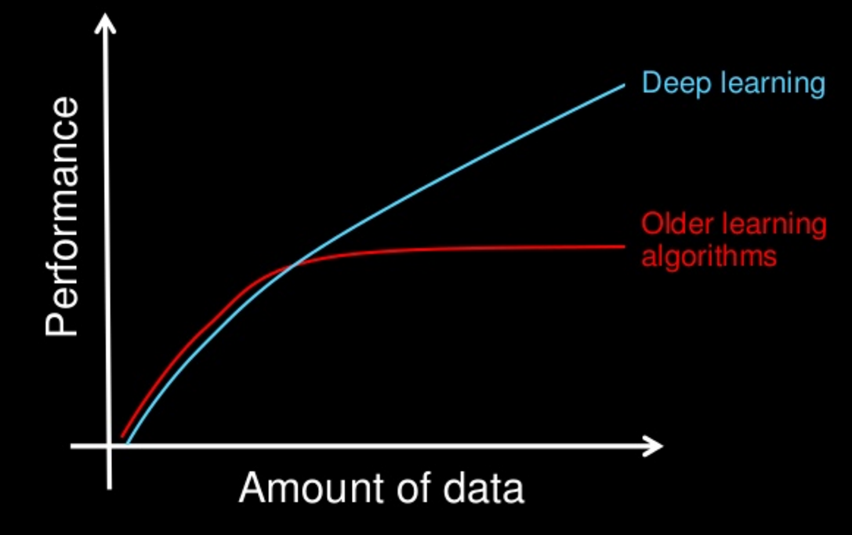
What Happened in the year 2000 – 2016?
Compute Power
2010 to 2016
Data Volume
Deep Learning
Algos
Notes:
Big Data, Computation, IOT Data, Cloud Computing

Slide 44
Logitech Data as a Glimpse
Inception – 1982
We have sold more than 700 million mice
Logitech has sold more than 100 million cordless mice and keyboards
By March 2006 - Introduced more than 130 new products and shipped more than 143 million products worldwide.

Slide 45
Consequence of Not Adopting Technology
Competitive Analysis
Predictive Analysis
Not ready for the future
Vulnerable to fade off

Slide 46
What we have done?

Slide 47
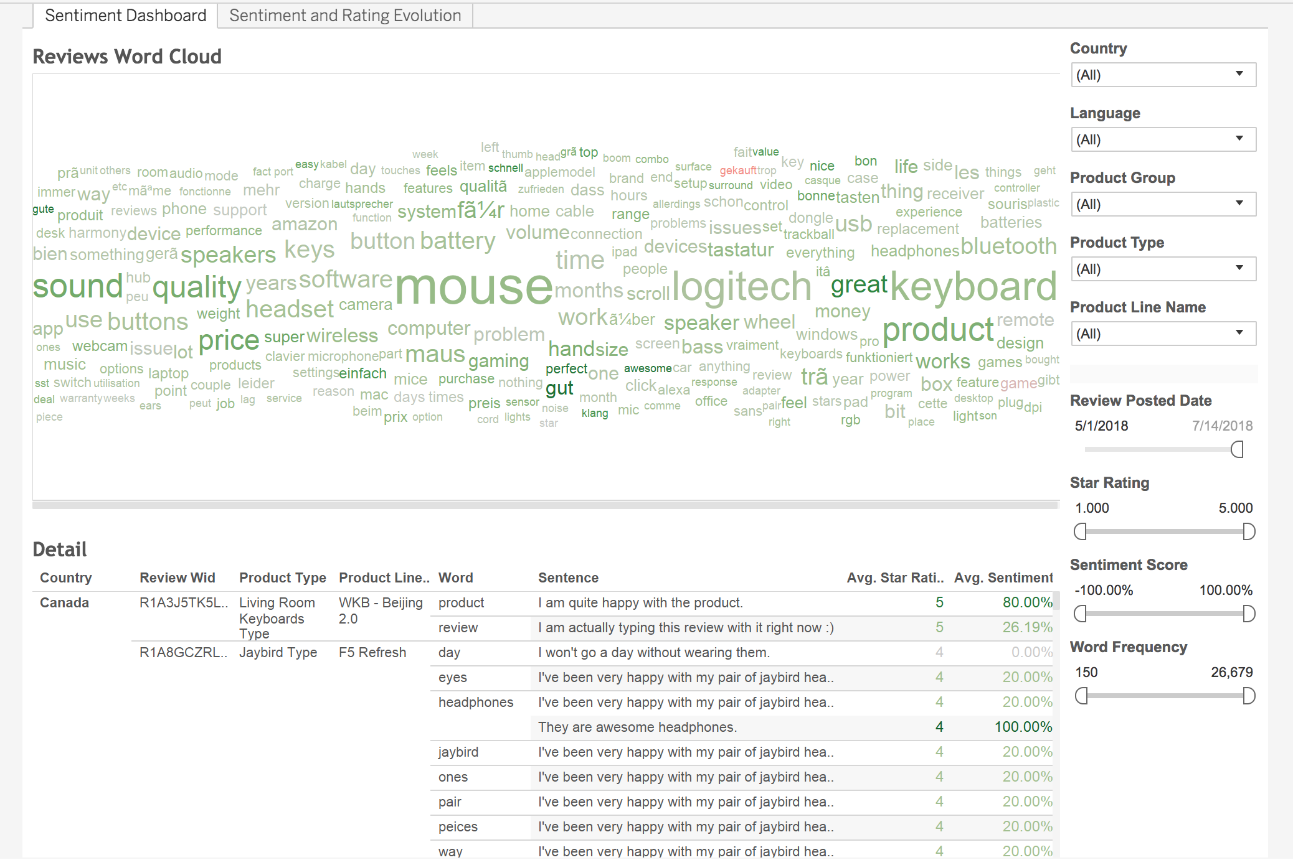
Amazon Sentiment Analysis
https://tableau.logitech.com/#/site/Logitech/views/WordCloudAmazonReviews/SentimentDashboard?:iid=1
Objective : Increased Customer Service
Notes:
Proactive support

Slide 48
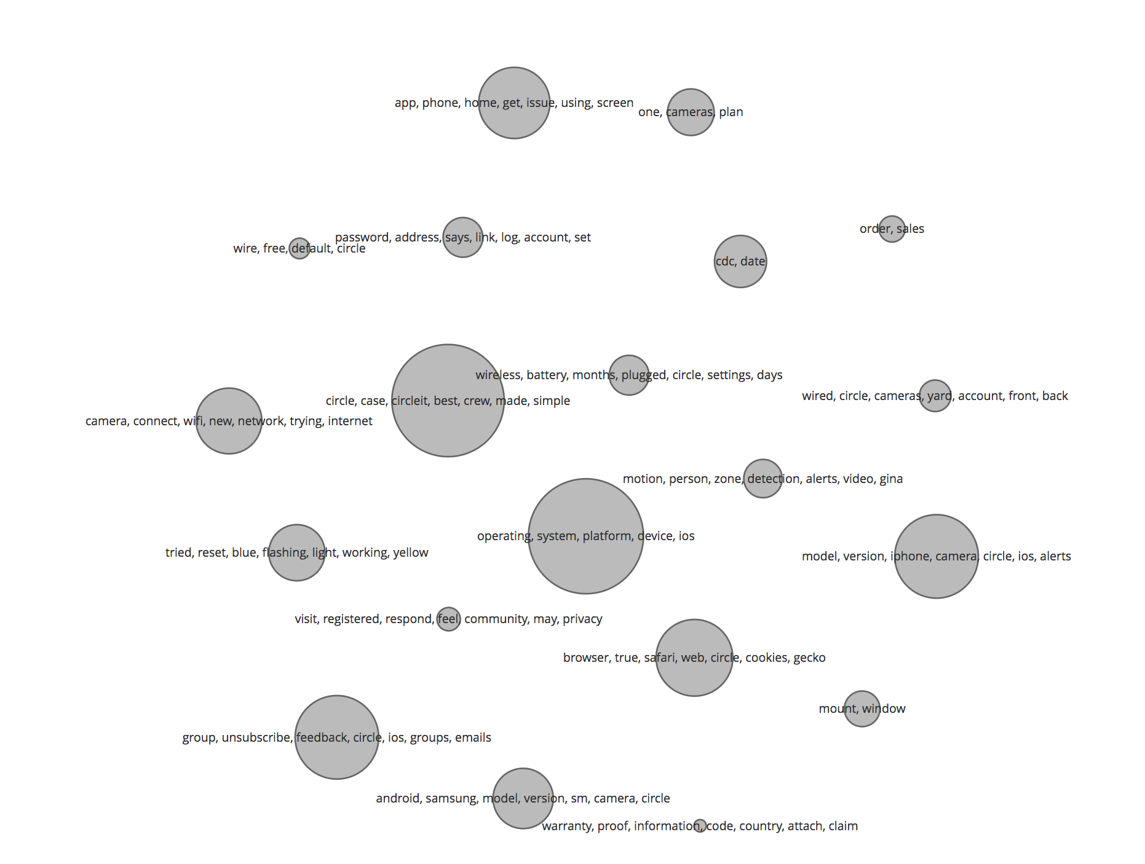
Topic Modelling
http://localhost:2030/topic_cloud.html
Objective : Operational Efficiency
Notes:
Proactive support

Slide 49
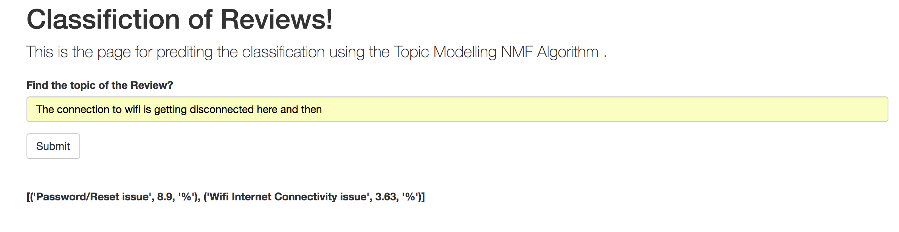
Topic Model Prediction
Notes:
Proactive support

Slide 50
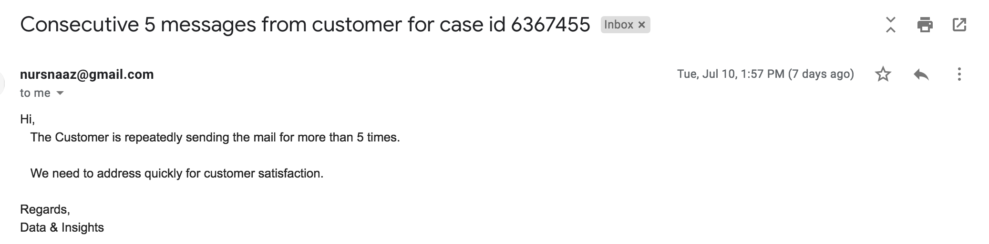
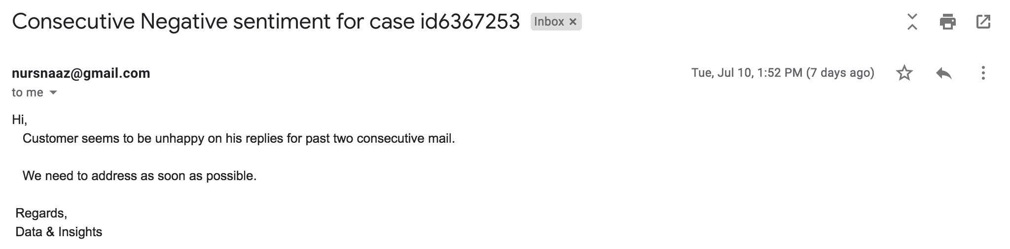
Customer care sentiment
Objective :
Increased Customer Service
Operational Efficiency
Notes:
Proactive support

Slide 51
Take Away!!!
Ponder on the Importance of Data Science Team.
What it solves?
Core of organisation.
Works Horizontal in global.
Start thinking how u can use data science applicable?

Slide 52
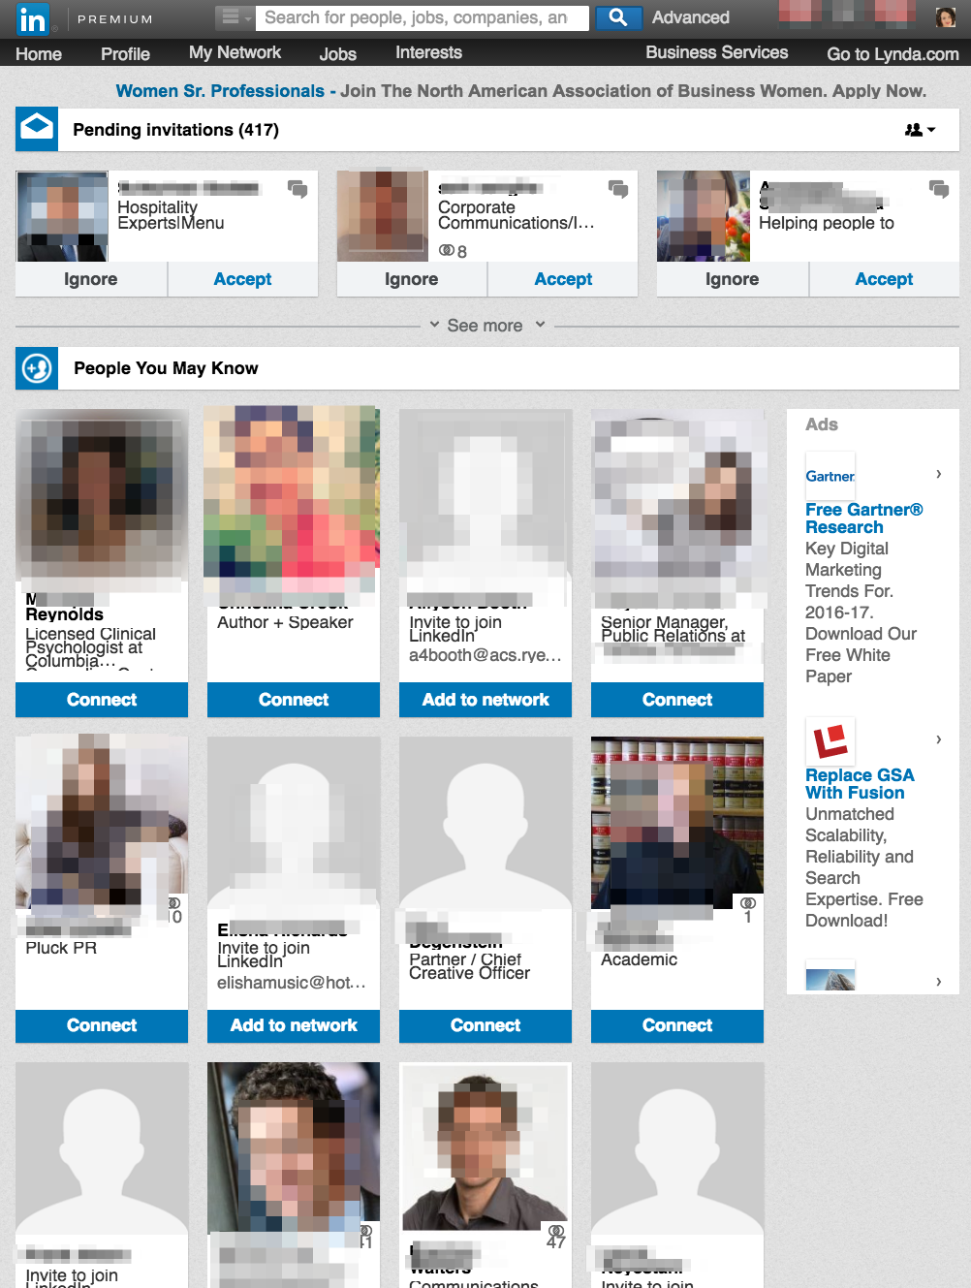
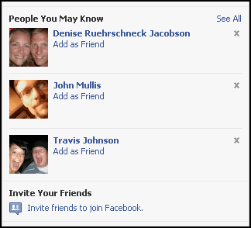

Slide 53
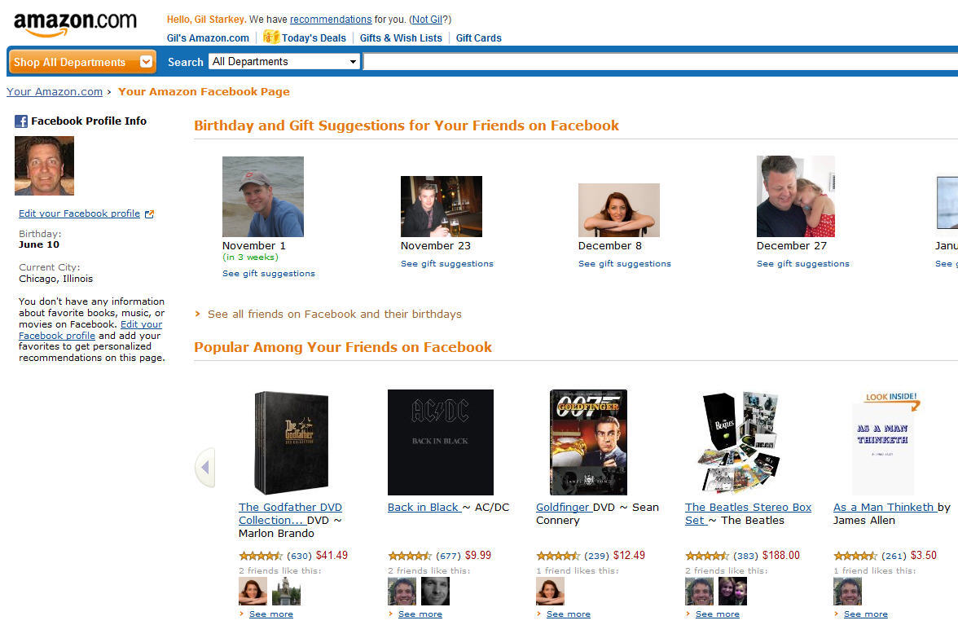
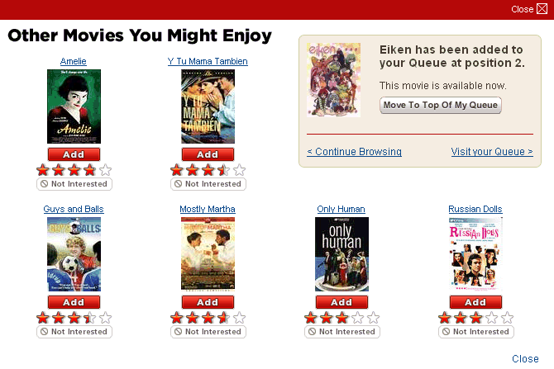

Slide 54
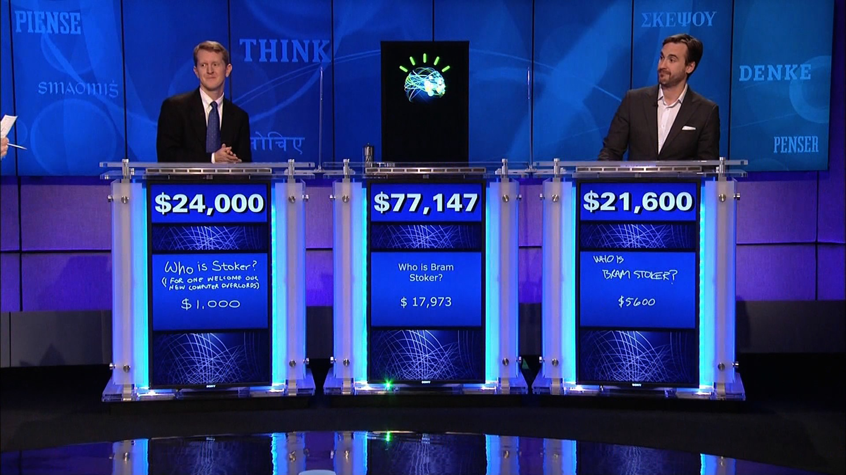

Slide 55
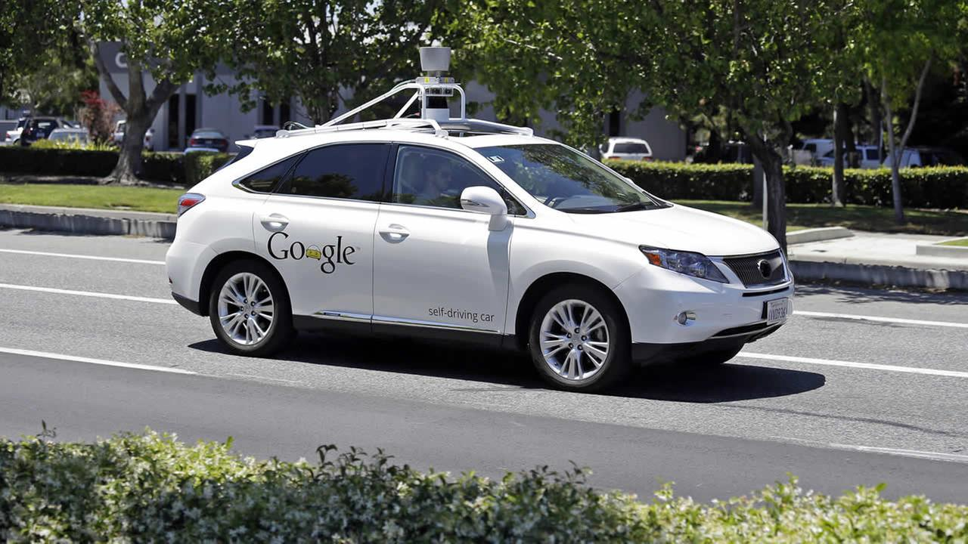

Slide 56
Computers can Learn

Slide 57
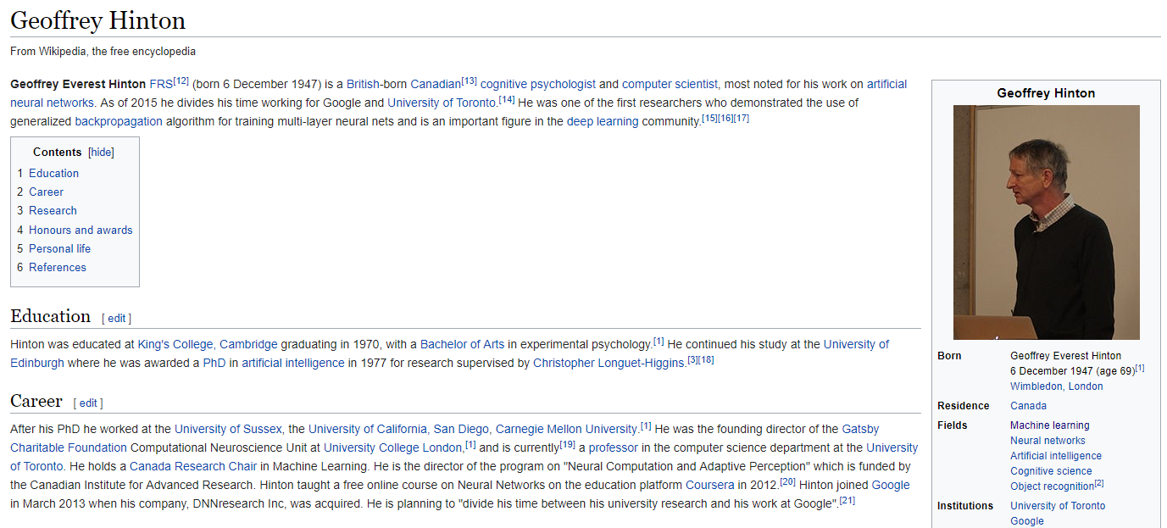
Automatic Drug Discover

Slide 58
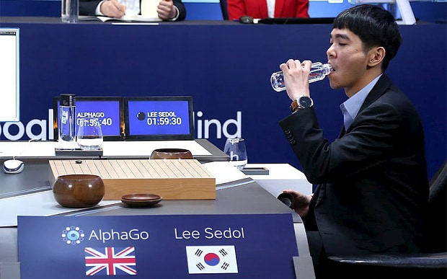
Google Deep Mind

Slide 59
Computers Can Listen And Understand

Slide 60
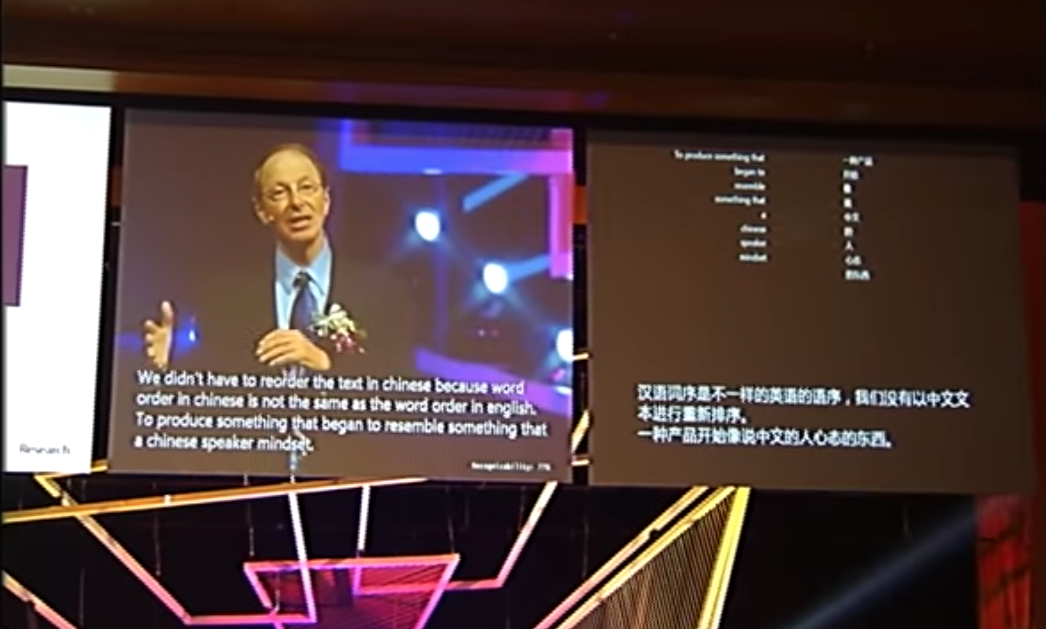
Speech Translation And Generation

Slide 61
Computers Can See

Slide 62
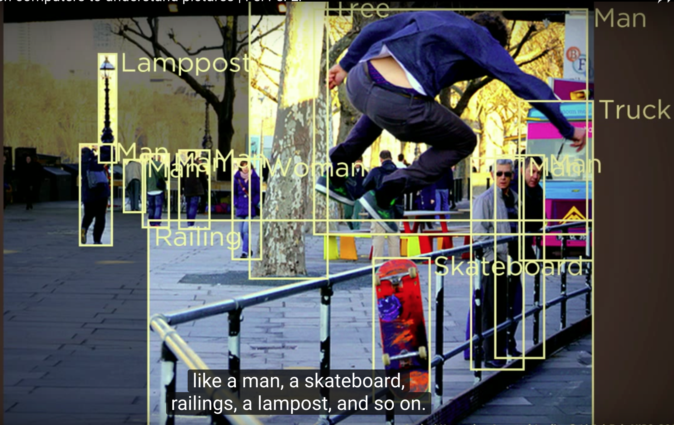
Image Recognition

Slide 63
Some Interesting things around AI
Artificial Intelligence created its own Movie
https://arstechnica.com/gaming/2016/06/an-ai-wrote-this-movie-and-its-strangely-moving/
Artificial Intelligence created its own Music
https://www.youtube.com/watch?v=3OEmzI52stk
Artificial Intelligence created its own Art
https://www.youtube.com/watch?v=Sbd4NX95Ysc

Slide 64
For Future

Slide 65
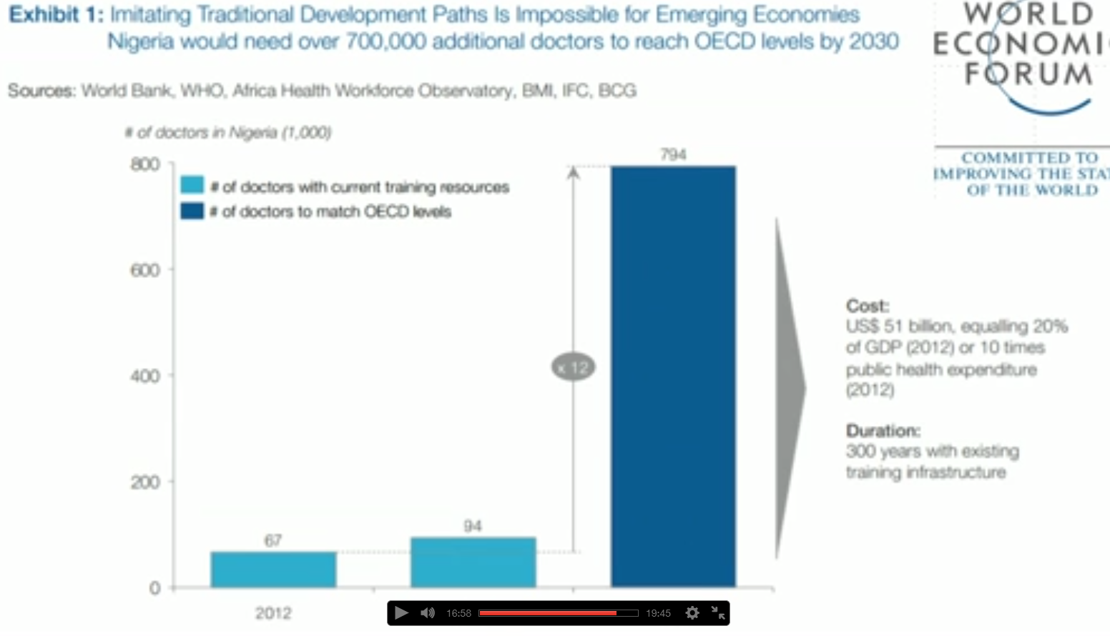

Slide 66
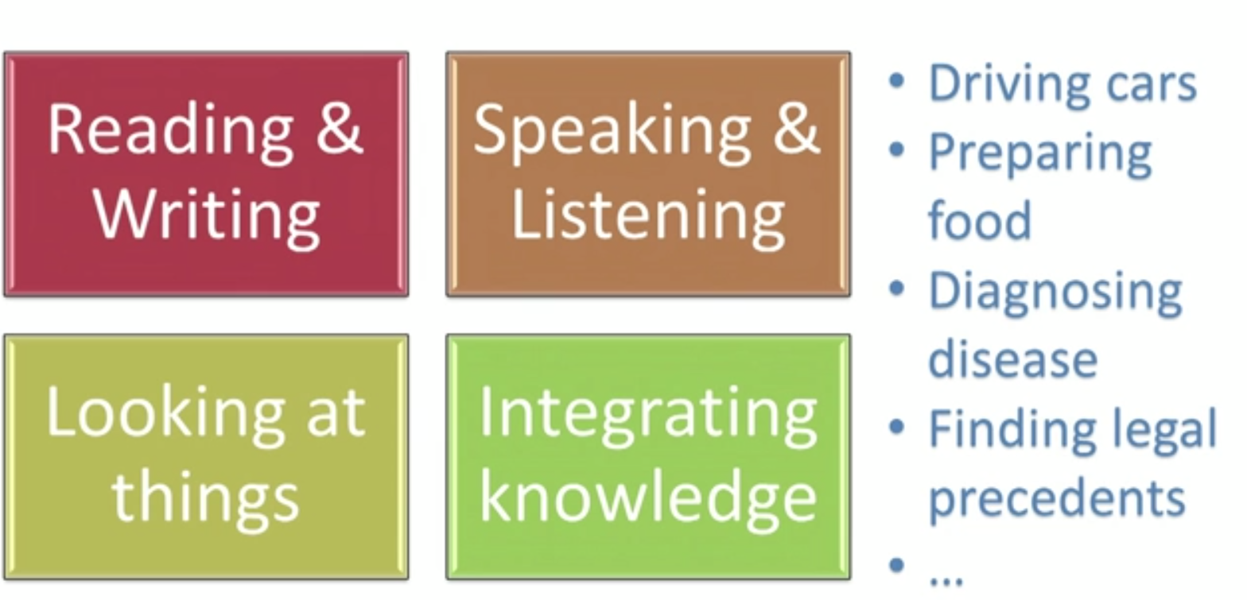

Slide 67
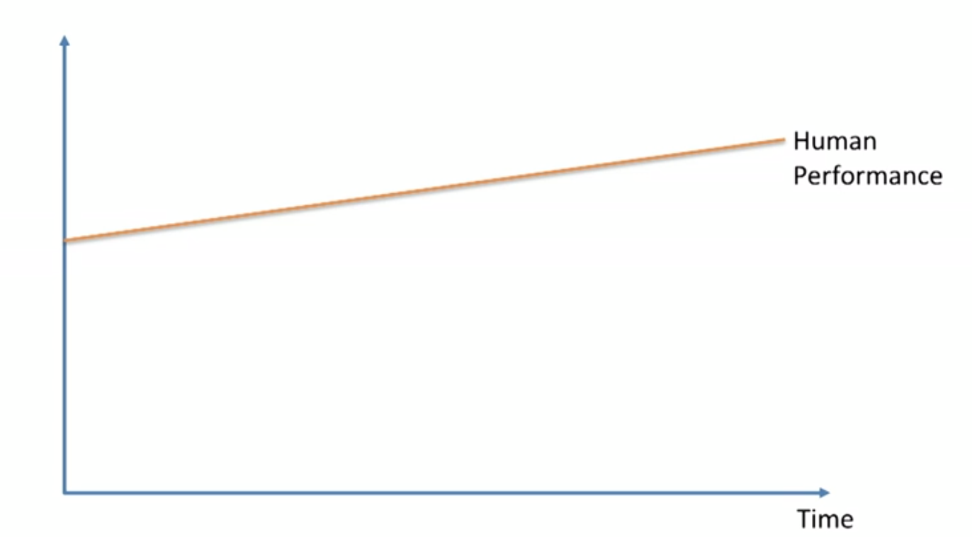

Slide 68
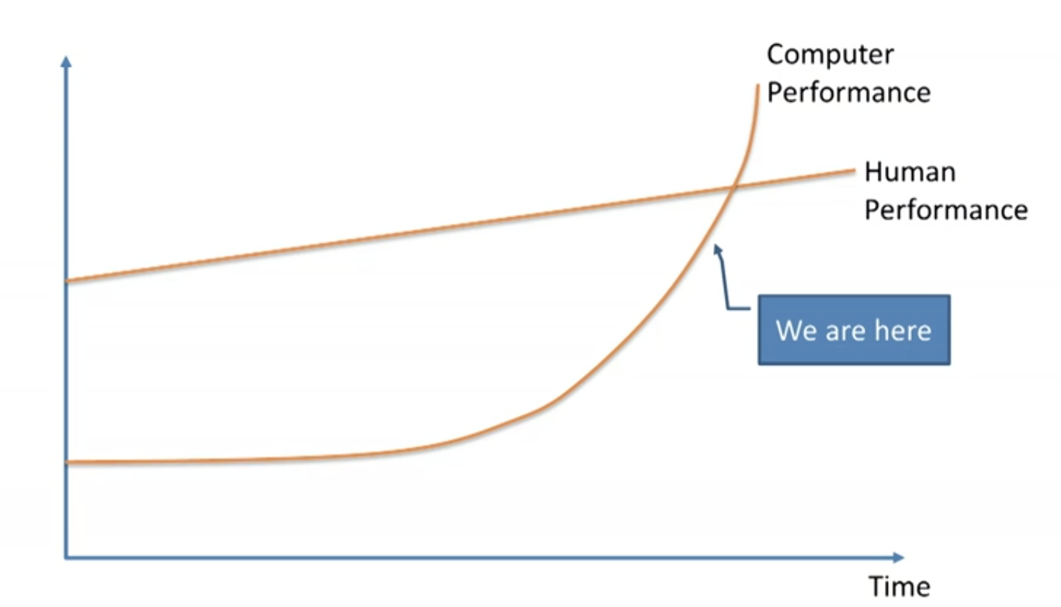

Slide 69
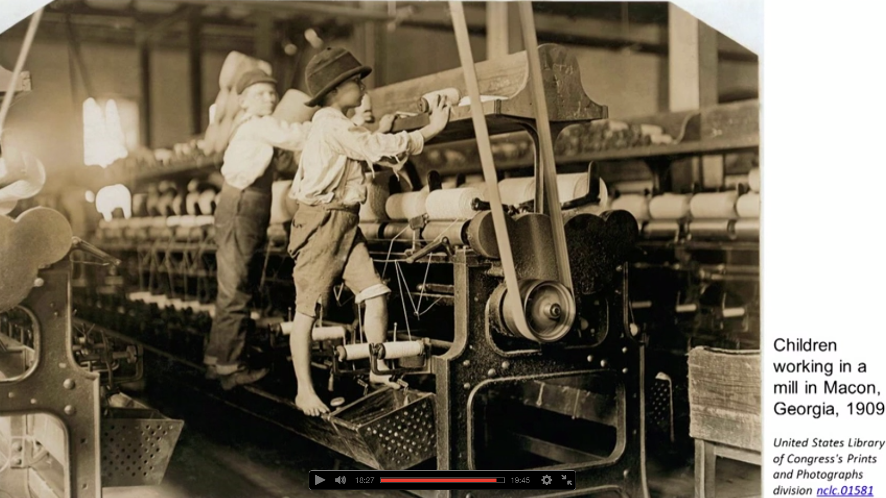

Slide 70
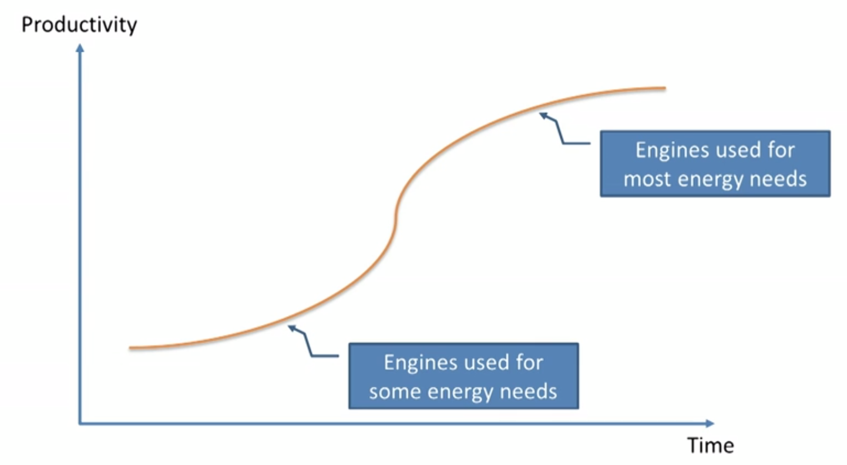

Slide 71
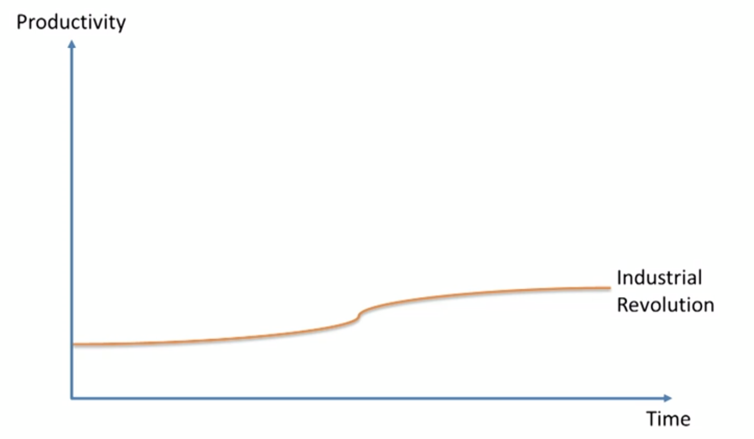

Slide 72
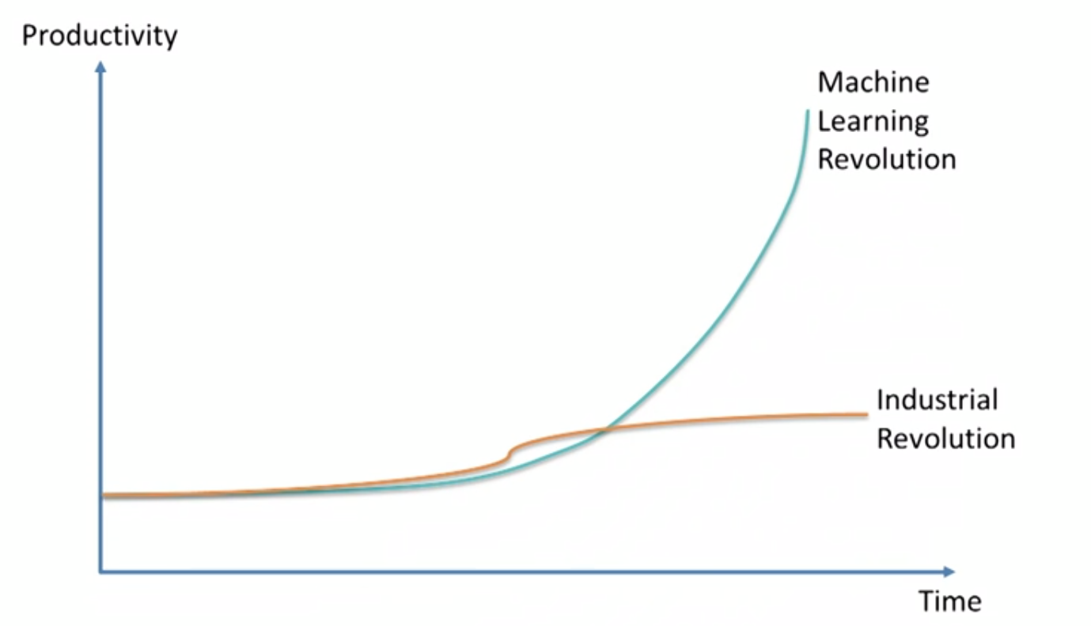

Slide 73
Future Jobs - Michio Kaku - Physicst
Those of Artificial intelligence can’t do
Pattern recognition and common sense are big problem of AI
Repetitive jobs will be wiped off
Jobs involved in intellectual capitalism will shine like
Leadership
Creativity
Analysis
Imagination
Telling joke
Writing a story, script

Slide 74
How to Tame it?

Slide 75
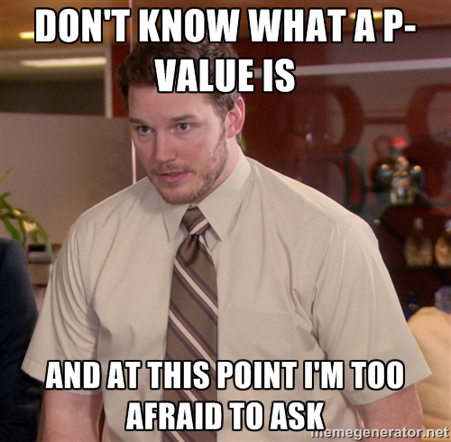
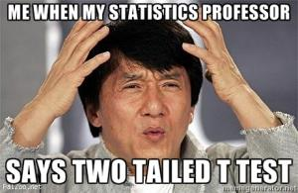
Revise Statistics and Probability

Slide 76


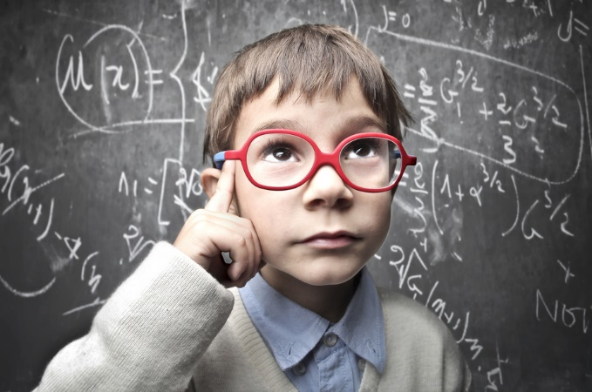
Learn algorithm how it works rather concentrating on output

Slide 77
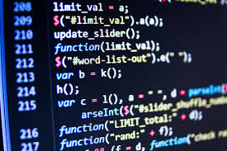

Learn and practice a programming language

Slide 78

Big data and Data science are happily married

Slide 79

Practice all algorithm with each use case

Slide 80


Make use of Kaggle and Analytics vidhya

Slide 81


Contribute your work to Opensource

Slide 82


Write a blog

Slide 83


Make your resume attractive

Slide 84
References
https://www.ted.com/playlists/310/talks_on_artificial_intelligen
http://www.kdnuggets.com/
https://www.youtube.com
https://www.cubs100.org/GetImage.aspx?IDMF=ea11fbcd-1eb1-4829-9276-41f91b5bd75a&w=900&h=600&src=mc
https://securityledger.com/wp-content/uploads/2016/05/IBM-Watson.jpg

Slide 85
Syllabus
Python Basics
Python Libraries for Machine Learning
Statistics
Probability
Linear Regression
Logistic Regression
Naïve Bayes
KNN
Decision Tree
Random Forest
AdaBoost
Stacking
SVM
K-means, K-means++
Time Series
Deep Learning(Neural Networks, CNN, RNN)
Text Analytics

Slide 86
THANK YOU

